Slide 1

CT Retirement Savings Program Update
Prepared for Connecticut Retirement Security Authority
Investing how you least expect it
March 19, 2021

Slide 2
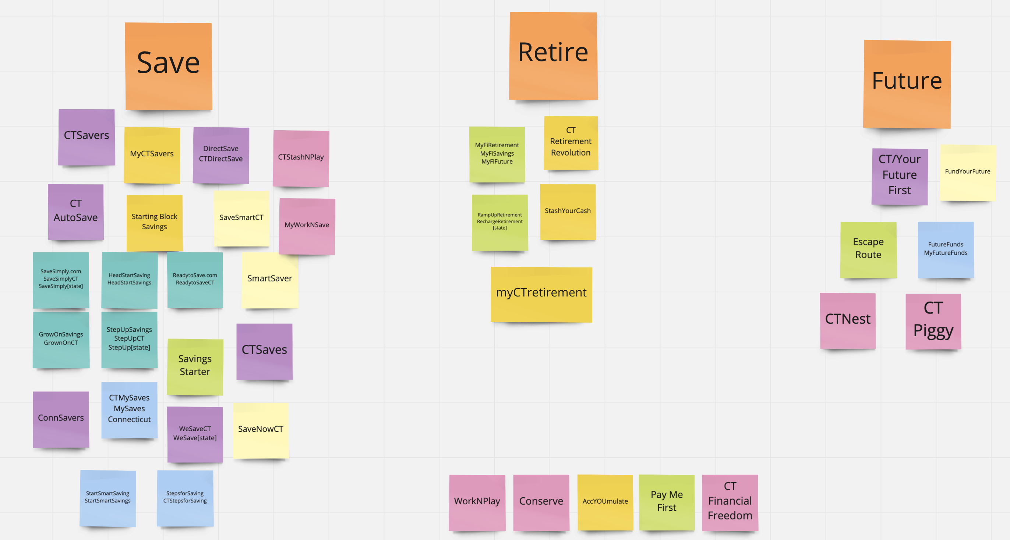
CRSA Brand Process
DISCOVERY
Multiple rounds of collaboration and exploration with CRSA and Sumday teams.
Key themes:
  “Savers” actively working now
  Diversity of company/job types
DESIGN
Name, Tagline, Logo, Color palette, Typography, Photography, Website design
DELIVERY
Marcom site, forms + PDB, brochures, etc.
Confidential – BNY Mellon 2021

Slide 3
Naming and Tagline Exploration
After a collaborative brainstorm session, the concept of "Saving" generated the most results and was the clearest and shortest way to quickly convey who we are/what we are/what we do.
Leveraging the word “retirement" came in second but presented challenges as far as name length and availability – so we opted to bring that into the tagline.
Shorter, more explicit names we found to be easier to recall and understand - and they provide less room for user error/typos.
Confidential – BNY Mellon 2021

Slide 4
Branding: Name Contenders and Chosen Option
 | SmartSaver | CTSaves CTSavers | ConnSavers
Umbrella Brand | X
Version-able for other states | X (CTSmartSaver) | X
Unique to CT |  |  | X
Short |  | X | X
Easy-to-recall | X | X | X
Confidential – BNY Mellon 2021

Slide 5
Branding: Tagline Contenders and Chosen Option
A flexible variety of taglines were crafted to speak either directly to savers or all members
CT Savers
The easy way to save for retirement from the State of CT
The easy way to save for retirement in the State of CT
CT Savers
Retirement saving, simplified
Retirement saving made simple
CT Savers
The easy way to invest in your future
The simple way to save for your future
A new way to save for the future
Confidential – BNY Mellon 2021

Slide 6

CRSA Branding: Name + Logo
Confidential – BNY Mellon 2021

Slide 7

CRSA Branding: Logo Variants
Logo works with b+w and at different scales
Confidential – BNY Mellon 2021

Slide 8
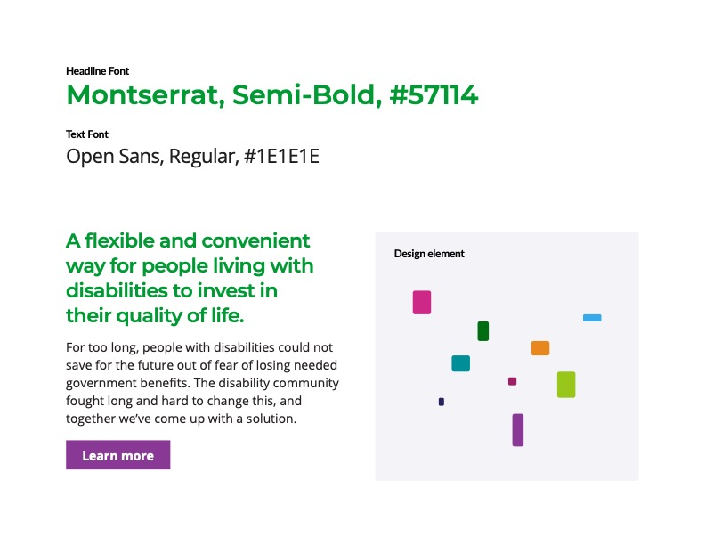
CRSA Portal Branding
Brand attributes
Confidential – BNY Mellon 2021

Slide 9
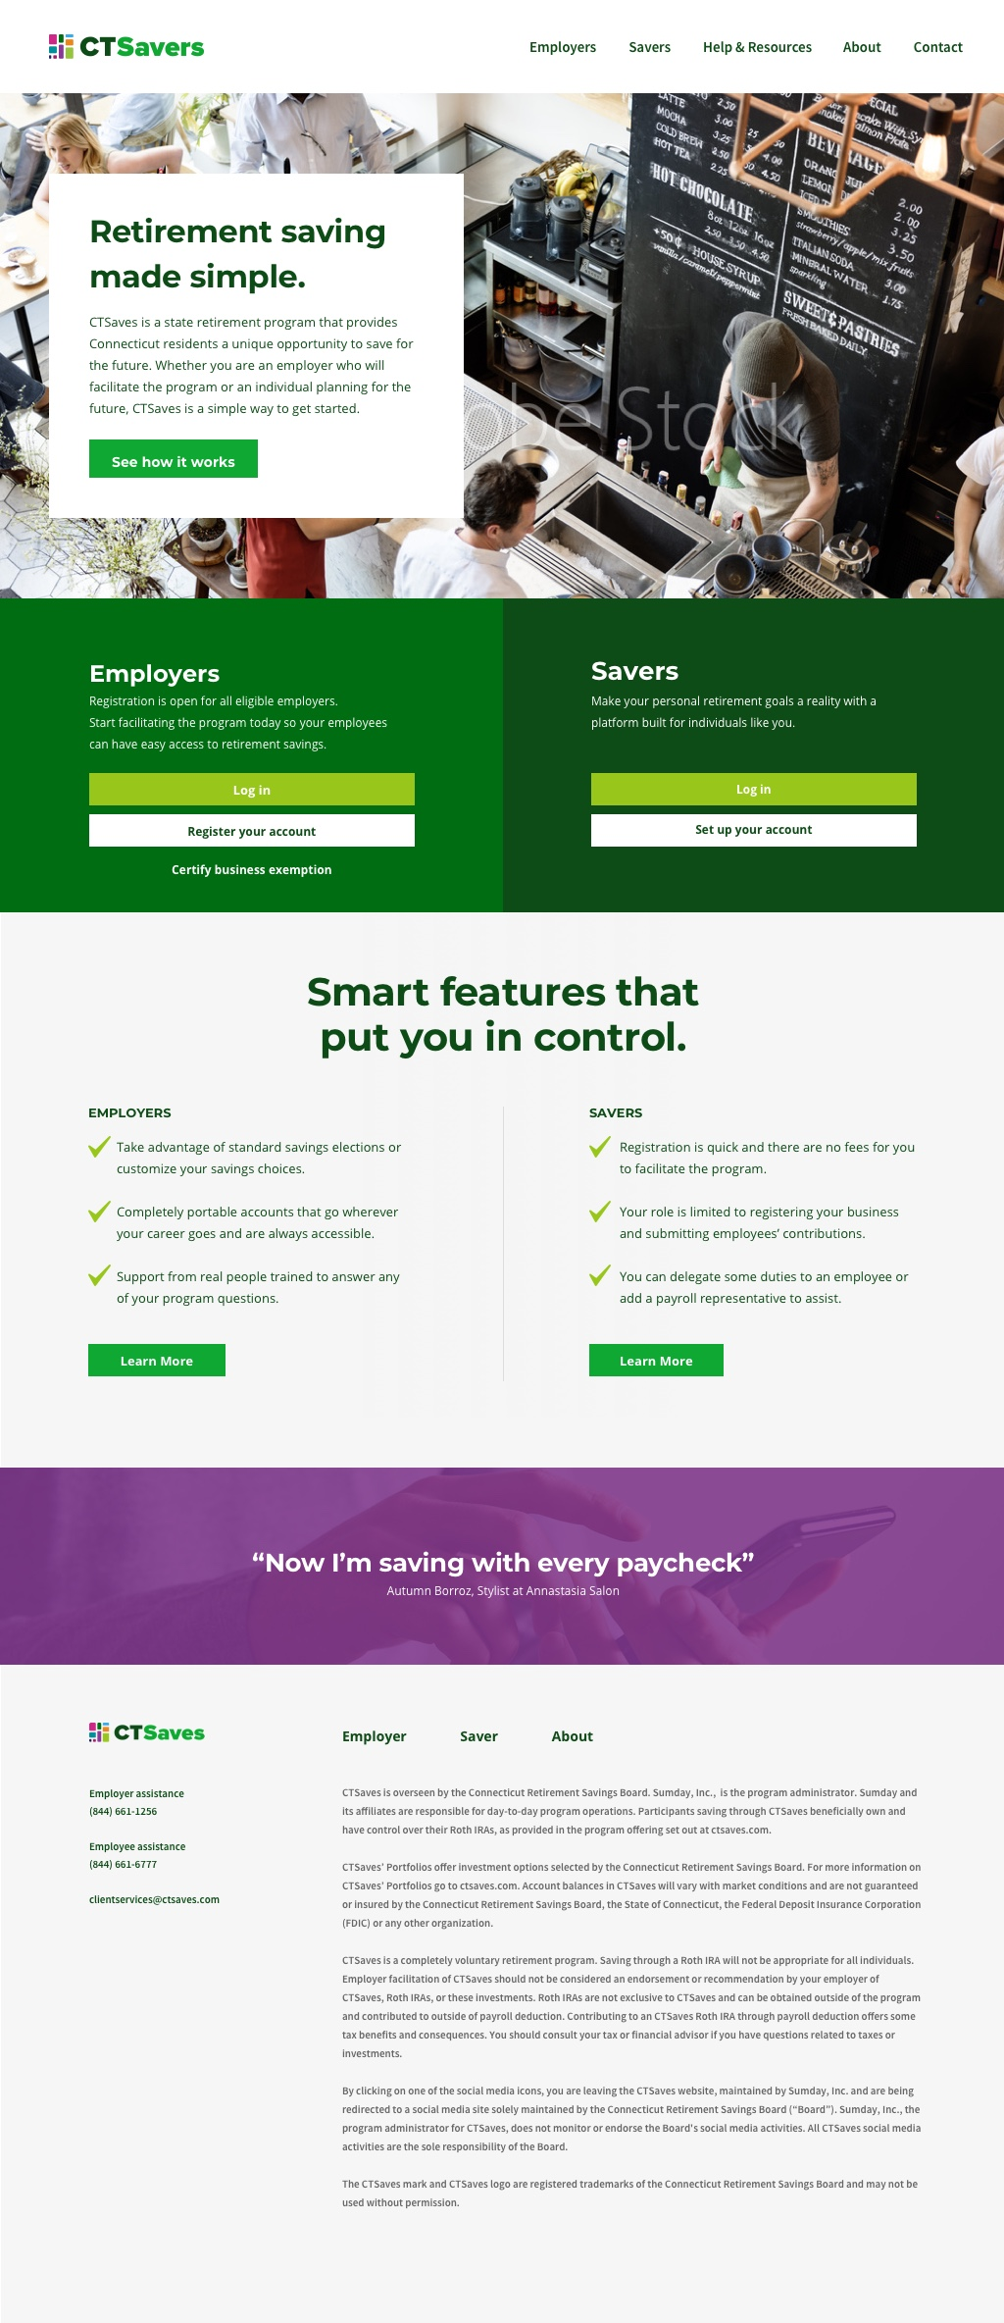
CRSA Portal Branding
Marketing site design
Confidential – BNY Mellon 2021

Slide 10
Target Launch Timeline and Key Dependencies
Confidential – BNY Mellon 2021

Slide 11
Discovery / Design / Development / Testing
Pilot
JAN | FEB | MAR | APR | MAY | JUN | JUL | AUG
Program Oversight
Discovery / Planning & Setup
Record Keeping & Operations Planning & Setup
Call Center Setup & Training
Call Center Available
CT Program Branding & MarCom Site Design
Branding Discovery & Planning
Marcom Site: Content Strategy, Design & Copy Deck, Site build
Content Matrix
Marcom Content
Communication Plan & Roll out
Portal Discovery, Planning, Design & Development
Kickoff in Jan
Target Pilot Date: 7/6/21
Target ER Pilot Feedback: 8/31/21
Target Wave 1 Launch: 11/21

Slide 12
Key Dependencies for Successful Launch
Securing Employer Data Set - with minimum required data points for successful launch
Developing and Approving Program Operational Rules
Completion of Development and Build of Employer and Employee Administrative Portals
Approving Investment Portfolios
Identifying and Securing an Appropriate Set of Pilot Employers
Confidential – BNY Mellon 2021

Slide 13


Thank you

